Slide 1


CS113 - ĐỒ HỌA MÁY TÍNH VÀ XỬ LÝ ẢNH
Buổi 2: Kiến thức cơ bản

Slide 2
Vectors

Slide 3
Vectors
● A vector is a magnitude and a direction
● Magnitude = ||v||
○ Also known as norm, length
● Direction
○ Represented by a unit vector (length of 1)
○ Often denoted by a hat above the letter
Notes:
https://www.stdio.vn/articles/read/45/vector-va-ung-dung-cua-chung
Vector là một đại lượng biểu diễn cho cả độ lớn và hướng.

Slide 4
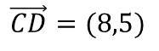
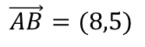
Vectors
● A vector is a magnitude and a direction
● Magnitude = ||v||
○ Also known as norm, length
● Direction
○ Represented by a unit vector (length of 1)
○ Often denoted by a hat above the letter
● A vector is not a position
D(9,11)
$$\vec{CD}=(8,5)$$
C(1,6)
B(12,8)
$$\vec{AB}=(8,5)$$
A(4,3)
Notes:
https://www.stdio.vn/articles/read/45/vector-va-ung-dung-cua-chung
Vector là một đại lượng biểu diễn cho cả độ lớn và hướng.

Slide 5
Column vs. Row Vectors
row vectors
column vectors
switch back and forth with transpose

Slide 6
Vector addition
● Vector addition in ℛ1
○ Familiar addition of real numbers
● Vector addition in ℛ²
○ Component-wise addition
○ Result, v + v’, plotted in ℛ2 is the new vector

Slide 7
Adding vectors visually
● v’ added to v, using the parallelogram
rule
○ reposition v’ so that its tail is at the head of
vector v
○ define v + v’ as the head of the new vector
● Or equivalently, add v’ to v

Slide 8
Adding vectors visually
geometric
algebraic
examples:

Slide 9
Vector subtraction
● Same as adding with a flipped vector
● Can find the vector between two
points
○ (8, 9) - (2, 4) = (6, 5) is the vector from the
house to the lightning
○ We know the magnitude of their distance
○ We know the direction between them

Slide 10
Vector subtraction
examples:

Slide 11
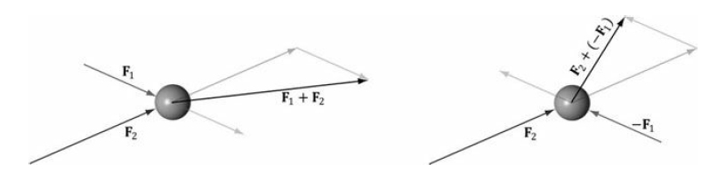
Example

Slide 12
Vector scalar multiplication
● Geometrically, think of scalar multiplication as scaling the vector
○ Magnitude is multiplied
○ Direction is not affected (unless zerod or negated)
● Scaled vectors are always parallel
○ Scaled components yield same slope

Slide 13
Linear dependence
● Set of all scalar multiples of a vector is a line through the origin
● Two vectors are linearly dependent when one is a multiple of the other
○ On the same line
● Definition of dependence for three or more vectors is trickier
○ Geometric intuition: in ℛ³ when on
the same plane, in ℛ^{n} when on the
same n-dim hyperplane

Slide 14
Basis vectors
● The unit vectors (i.e. whose length is one)
on the x and y-axes are called the
standard basis vectors
● The collection of scalar multiples of
gives the first coordinate axis
● The collection of scalar multiples of
gives the second coordinate axis

Slide 15
Basis vectors continued
● Any vector can be expressed as the
sum of scalar multiples of the unit
vectors:
● We call these two vectors basis vectors
for ℛ2 because any other vector can be
expressed in terms of them
○ Very important concept
○ Can you guess what the standard basis vectors
for ℛ3 are?

Slide 16
Non-orthogonal basis vectors
● and are perpendicular. Is this necessary?
● Can we make any vector from scalar multiples of random vectors and ?
● Is there a solution for all n, m to the following, where α and β are unknown?

Slide 17
Non-orthogonal basis vectors continued
● Is there a solution to the following, where α and β are unknown:
○ Just a linear system of two equations. When is this unsolvable? How does it make sense geometrically?

Slide 18
Dot product
● Operation on two vectors
● Result is a scalar!
○ Also known as scalar product or inner product
● Defined for vectors of any size
○ Both vectors must have the same size
Notes:
Tích vô hướng hai vector

Slide 19
Calculating magnitude using dot product
● Let’s find magnitude of vector v from
origin to house
● Use Pythagorean theorem (2D only)
● Use dot product (All dimensions!)

Slide 20
Find angle between two vectors
● Let’s find angle between v and x-axis
● Angle between two vectors is θ,
where

Slide 21
Determining right angles
● Angle between two vectors is θ,
Where
● If θ is a right angle, cos(θ) = 0
● So if a and b are perpendicular,

Slide 22
Projections
● Let’s find projection of v onto x-axis

Slide 23
Projections continued
● Projections in general
● Used compute v vector from up vector
○ Subtract projection of up onto look -> get rid of
component that isn’t perpendicular
● In mathematical terms, the
projection of vector a onto vector b
○ Length times unit vector in
direction of b
● And the length of the projection

Slide 24
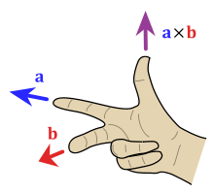
Cross product
● Operation on two 3D vectors
○ Two vectors define a plane
● Output is a vector!
○ Follows right-hand rule
○ Result is a vector perpendicular to plane
defined by input vectors
○ Its magnitude is equal to the area of the
parallelogram formed by the two vectors
● In terms of vector components, the
cross product is calculated
● Note: vectors can be anything, don’t have to be in xy plane
Notes:
https://en.wikipedia.org/wiki/Cross_product
Tích có hướng hai vector
https://vi.wikipedia.org/wiki/T%C3%ADch_vect%C6%A1

Slide 25
Matrix

Slide 26
Matrix
● A matrix is a rectangular array of
numbers or other mathematical objects
● Can operate on with addition
(matrix-matrix) and multiplication
(scalar, vector, and matrix)
● Size: m x n → rows x cols
Notation:
Notes:
For the purposes of this class, matrices are
used to represent transformations, which act
on points, vectors, and other matrices

Slide 27
Product of row vector and column vector
● We haven’t stressed this so far
● But there is distinction between vector written as row vs. vector written as
column
○ Use column vectors usually
● Product of a row vector and column vector denoted
○ Vectors must be the same size
● Result is actually dot product of these two vectors

Slide 28
Matrix and vector multiplication
● Matrix-vector multiplication
produces a new vector.
○ v’ = Mv
○ Both v and v’ column vectors
● kth element of v’ is the product
kth row of M with v
○ Same as the dot product of kth row of
M with v
● If M is an m x n matrix, v must be
length n
○ Otherwise dot product not defined
● Use cases for matrix-vector multiplication
○ Transform vertices into world space /
camera space / screen space
○ Transforming normal vectors (more later)
○ Moving and animating graphical models
● A lot of what we do comes down to
matrix-vector multiplication

Slide 29
Matrix-Matrix Addition
add: matrix + matrix = matrix
example

Slide 30
Matrix and matrix multiplication
● MNij = the dot product of the ith
row of M and the jth column of N
○ Product of ith row vector of M and jth
column vector of N
○ Subscript denotes row, then column
● If M is an m x n matrix, then N
must be an n x k matrix.
○ Otherwise, dot product of ith row and
jth column would not make sense
● MN is an m x k matrix
● Order of multiplication matters!
○ In general MN ≠ NM
○ NM may not even be defined!

Slide 31
Scalar-Matrix Multiplication
multiply: scalar * matrix = matrix
example

Slide 32
Matrix multiplication identity
● Scalar operations like addition and multiplication have identities
○ a + 0 = a
○ a * 1 = a
○ 0 for addition, 1 for multiplication
● What is the identity for matrix multiplication?
● The identity matrix I is a matrix with all zeroes, except for on the diagonal, where
it is all ones
○ Identity matrix exists for different dimensions
● Multiplication of an object (matrix or vector) by identity produces original object

Slide 33
Properties of Matrix Multiplication
● Properties similar to scalar multiplication
● Associative property
○ (AB)C = A(BC)
○ Important for combining transformations -- we can combine and group adjacent
● Distributive property
○ A(v + v’) = Av + Av’ [vectors]
○ Use transformation of component parts to transform complicated vector
● Identity
○ AI = A = IA
● Inverse (more later)
○ For some A, there is a matrix A-1 such that
○ AA-1 = I = A-1A

Slide 34
Visual Matrix Multiplication
● Since matrix multiplication is distributive
over vectors, we can tell where each vector
will be sent by knowing where each
standard basis vector is sent
● Originally, we have a unit grid
● Then we apply transformation and set up a
grid based on images of two standard basis
vectors

Slide 35
Visual Matrix Multiplication continued
Now to see where ends, instead of going 2
steps along x-axis, and 3 along y-axis, go 2
steps along image of and three along image
of

Slide 36
Inverse of a Matrix
● A and B are inverses if
AB = BA = I
● Some matrices don’t have an
inverse matrix
● Matrices for rotation, translation,
and scaling have inverses
What does an Inverse do?
● The inverse A-¹ of transformation A will
“undo” the result of transforming by A
● If A scales uniformly by a factor of two and
then rotates 135 degrees, then A-¹ will
rotate by –135 degrees and then scales
uniformly by one half

Slide 37
How to get the inverse
● Use Gauss-Jordan elimination
● To find A-1 with Gauss-Jordan
elimination
○ Augment A with I to get [A|I]
○ Reduce the new matrix into reduced
row echelon form (rref)
○ The matrix is now in the form [I|A-1]
To reduce a matrix into rref we are allowed to
perform any of the three elementary row
operations. These are:
● Multiply a row by a nonzero constant
● Interchange two rows
● Add a multiple of one row to another row

Slide 38
The inverse continued
● When do we need to use this method?
○ A lot of matrices inverses can be deduced without applying this process
○ For example, to invert normalizing transformation, the computer will apply inversion method
● Why does this method work?
○ Algebraic intuition: row operations are equivalent of operations on system of equations
○ System of equations invariant under these operations
● Another explanation
○ Row operations are actually matrix multiplications
○ Check this link out if interested: http://aleph0.clarku.edu/~djoyce/ma130/elementary.pdf

Slide 39
Example

Slide 40
Example

Slide 41
Homogeneous Coordinates
● Consider the vector (x, y) and the point
(x, y)
○ These are different things
○ How can we distinguish?
● Introduce the w component
○ Always either 0 or 1
○ (x, y, 0) is a vector
○ (x, y, 1) is a point
● This applies in any n-dimensional space

Slide 42
Translation in 2D (1/2)
● Consider this translation matrix T
● To verify that this is the right matrix, multiply it by our homogenized point:
● Coordinates have been translated, and v’ is still homogeneous

Slide 43
Translation in 2D (2/2)
● Now let’s try multiplying T by a 2D vector v instead of a 2D point
● v’ = v, which is what we want
○ A translation shouldn’t affect vectors, only points

Slide 44
Transformations Homogenized
● Let’s homogenize all our matrices! Doesn’t affect linearity of scaling and rotation
● Our new transformation matrices look like this…
● Note: These transformations are called affine transformations, which means they preserve ratios of distances between points on a straight line

Slide 45
Inverses
● When we want to undo a transformation, we’ll need to find the matrix’s inverse.
● Thanks to homogenization, they are all invertible!

Slide 46
Matrices and Linear Systems
linear system of n equations, n unknowns
matrix form Ax=b

Slide 47
Implicit and parametric objects

Slide 48
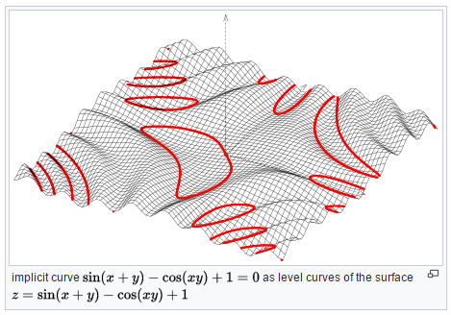
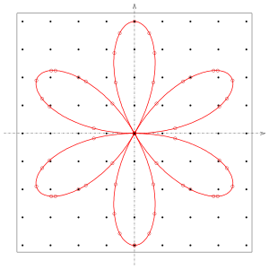
Implicit curves
Defined by implicit equation f(x,y)=0.
Implicit means, that the equation is not solved for either x or y.
Points solving the equation are on the curve.

Slide 49
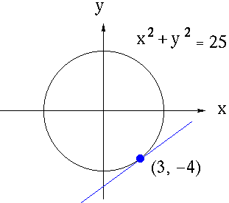
Implicit curves
Implicit circle equation (standard form)
(x−xc)²+(y−yc) ² −r²=0
Implicit circle equation (vector forms)
(p−c)⋅(p−c)−r² =0
∥p−c∥²−r² =0

Slide 50
Implicit 2D lines
Start with slope-intercept form and move y to other side
y=mx+b mx−y−b=0
More generally, we use 3 coefficients, A,B,C
f(x,y)=Ax+By+C=0
The vector n=(A,B) is perpendicular to the line.
If ∥n∥=1‖n‖=1, then f(x,y) is the signed distance of (x,y) from the line.
Q: Write the implicit equation of a 2D line as a dot product.
Notes:
Q: Write the implicit equation of a 2D line as a dot product.

Slide 51
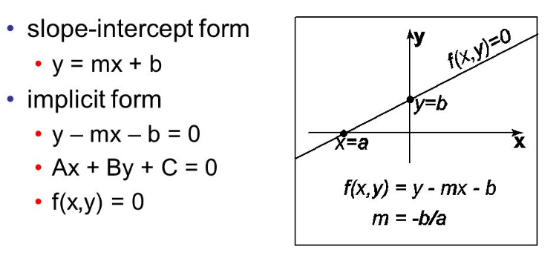
Implicit 2D lines

Slide 52
Implicit plane
Standard form adds a z term:
f(x,y,z)=Ax+By+Cz+D=0
We can reformulate using the plane normal, recognizing that the cosine of a right angle is 0. If a is a point on the plane, (p−a)⋅n=0 Since the dot product is distributive, we can rewrite this as p⋅n = a⋅n Substituting gives n=(A,B,C), and D=−a⋅n.
As with lines, f(p) gives the signed distance from the plane as long as n is unit length.
Notes:
P0 = (5, 4, 7) n = (1, 2, 2)
Q: How would you compute the plane equation of a triangle with vertices a,b,ca,b,c? Q: Rewrite the implicit equation of a plane as a single 4D dot product.

Slide 53
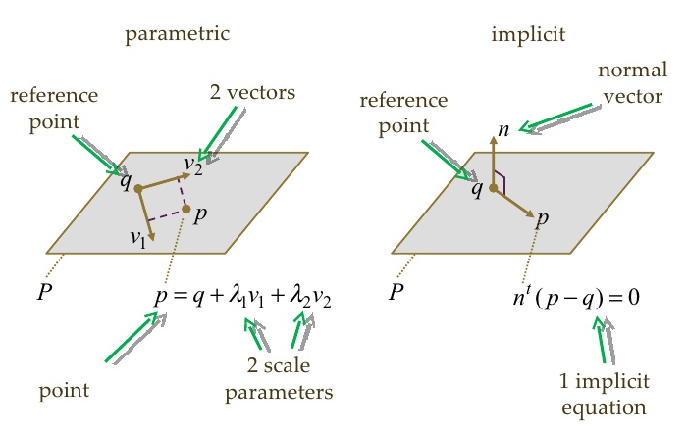
Implicit plane

Slide 54
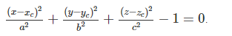
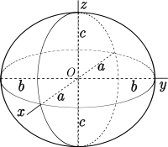
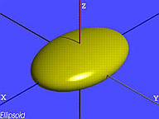
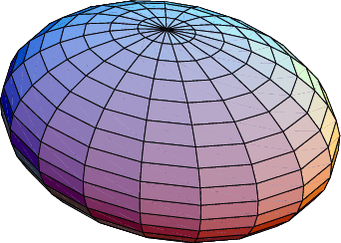
Implicit ellipsoid
Equation for a sphere is with center c=(xc,yc,zc), and radius 1 is
(x−xc)2+(y−yc)2+(z−zc)2−1=0 .
Let a, b, and c represent the axis lengths of an axis-aligned ellipsoid with center the same center. By “stretching” the sphere equation, we get the equation of an ellipse:

Slide 55
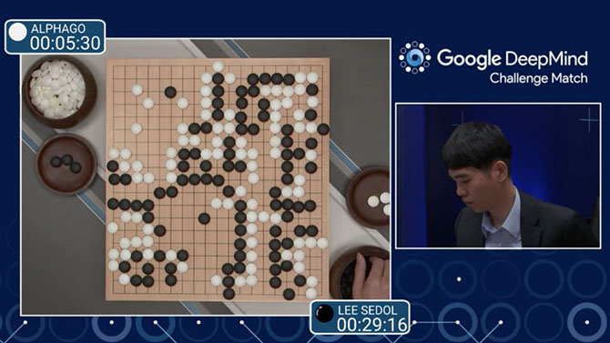
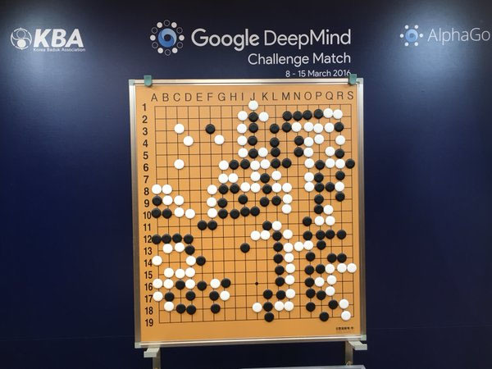
Implicit ellipsoid
Notes:
http://vnreview.vn/tin-tuc-khoa-hoc-cong-nghe/-/view_content/content/1782414/ai-cua-google-danh-bai-huyen-thoai-co-vay

Slide 56
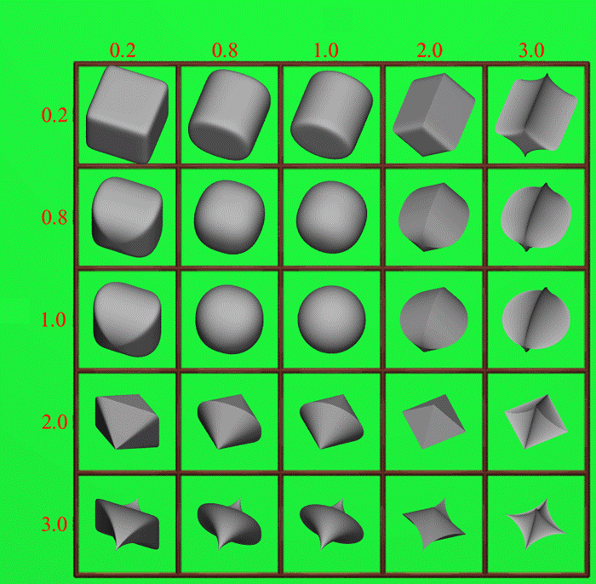
Superellipsoid Surfaces
Generalization of ellipsoid
Control parameters s₁ and s₂
If s₁ = s₂ =1 then regular ellipsoid
Has an implicit and parametric form!
s₂
s₁

Slide 57
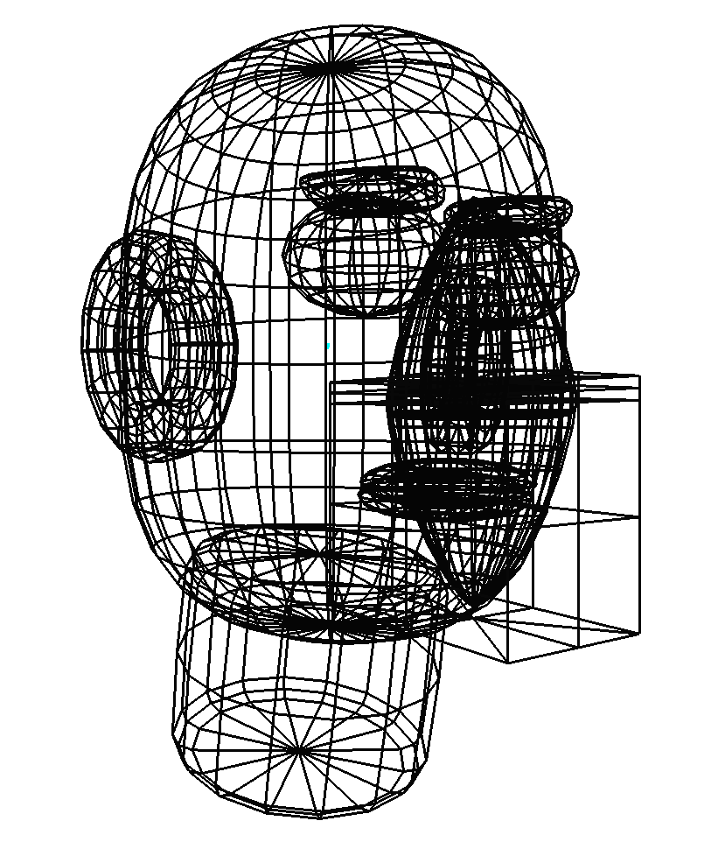
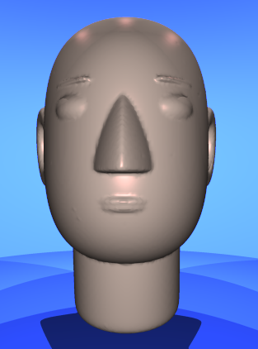
CSG with Superquadrics

Slide 58
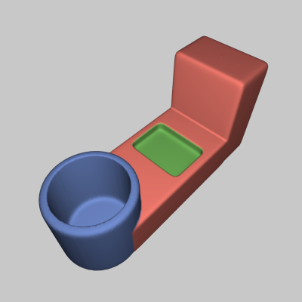

CSG with Superellipsoids

Slide 59
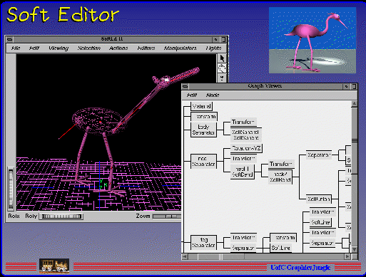
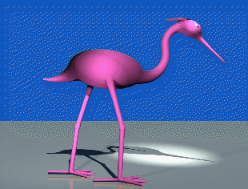
Implicit Modeling System/ U. of Calgary
Combine “primitives”
Points, lines, planes, polygons, cylinders, ellipsoids
Calculate field around primitives
View Iso-surface of implicit function

Slide 60
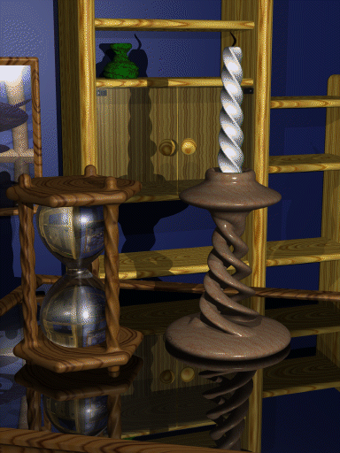
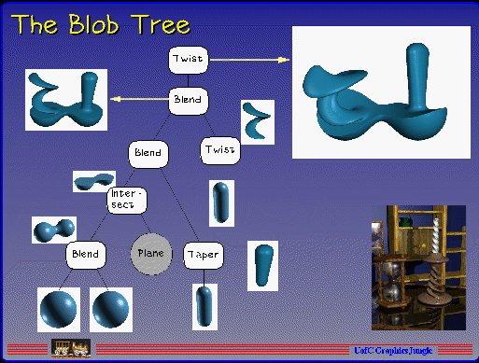
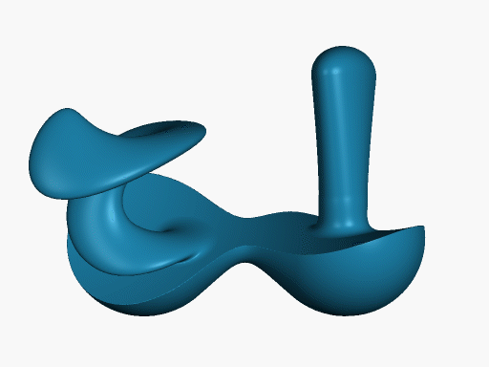
Implicit Modeling System/ U. of Calgary
Can apply blends and warps

Slide 61
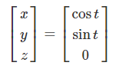
Parametric curves
Parametric curves define a curve based on a single parameter (t) which can often be written as separate equations for each coordinate. The curve below traces out a circle:
x=cost
y=sint z=0
We can rewrite this as a column vector
Notes:
Q: Change the above equation to make a spiral.

Slide 62
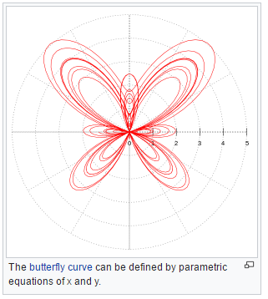
Parametric curves
Notes:
https://en.wikipedia.org/wiki/Parametric_equation

Slide 63
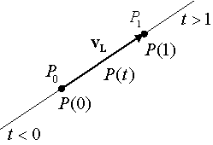
Parametric lines (rays)
A parametric line can be written in vector form as
p(t)=o+td p(t)=o+td
We often refer to this as a “ray”.
Q: What is p(2) if o=(1,4,7) and d=(1,−1,0)?

Slide 64
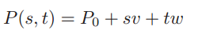
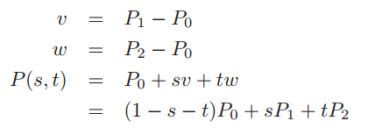
Parametric Plane
A point on the plane and two vectors that lie in the plane
Let the two vectors be v and w. We can then define the equation:
we have a triangle of three points, P0, P1, P2, and we develop it like this:

Slide 65
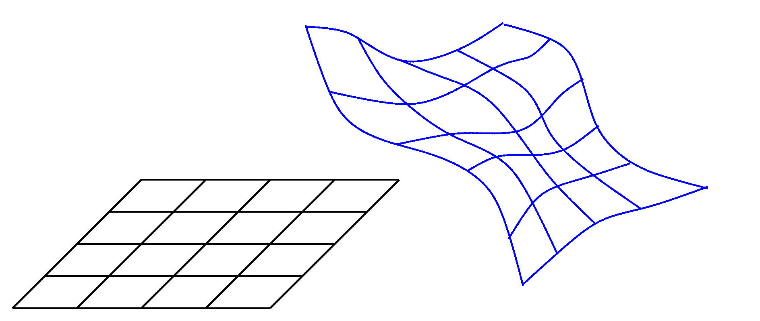
Parametric surfaces
By using 2 parameters, we can make a parametric surface. For example, the parametric form of a cylinder can be written
x=cosu y=v z=sinu
The normal to a parametric surface at p(u,v)p(u,v) is the cross products of the two partial derivatives of the surface:
n=pu×pv
Notes:
http://groups.csail.mit.edu/graphics/classes/6.838/F01/lectures/SmoothSurfaces/0the_s018.html

Slide 66
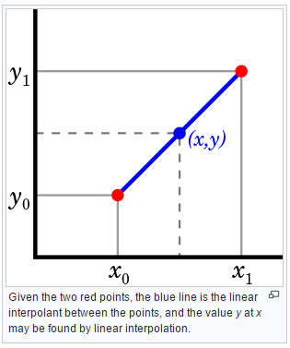
Linear interpolation
Linear interpolation gives us a way to “blend” or “mix” two scalar or vector values (a and b) based on a third t.
The interpolated value, c can be written in one of the following ways
c=(1−t)a+tb
c=a+t(b−a)

Slide 67
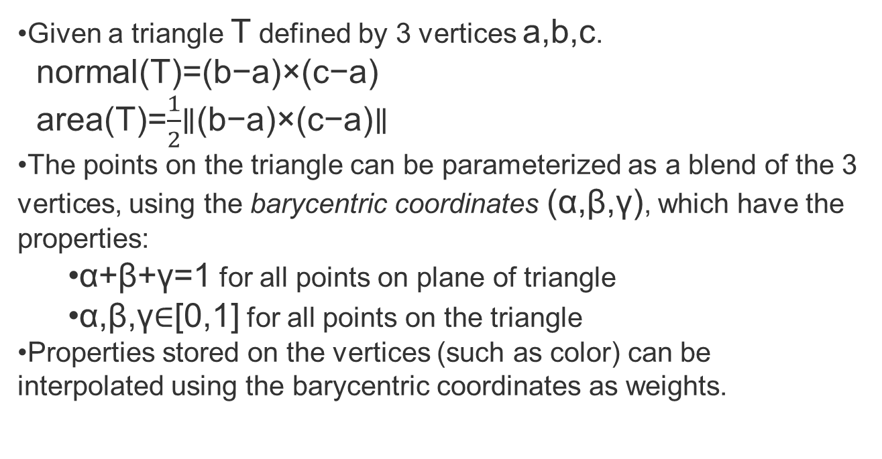
Triangles
Given a triangle T defined by 3 vertices a,b,c.
normal(T)=(b−a)×(c−a)
area(T)=$\frac{1}{2}$∥(b−a)×(c−a)∥
The points on the triangle can be parameterized as a blend of the 3 vertices, using the barycentric coordinates (α,β,γ), which have the properties:
α+β+γ=1 for all points on plane of triangle
α,β,γ∈[0,1] for all points on the triangle
Properties stored on the vertices (such as color) can be interpolated using the barycentric coordinates as weights.

Slide 68
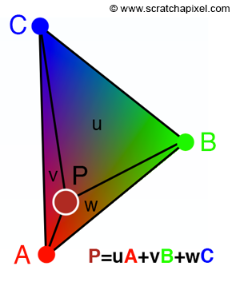
Triangles
barycentric coordinates can be used to interpolate vertex data at the hit point. In this example for example we compute the color at P using vertex color.
Notes:
https://www.scratchapixel.com/lessons/3d-basic-rendering/ray-tracing-rendering-a-triangle/barycentric-coordinates

Slide 69
